Slide 1



E Waste Generation Classification

Slide 2

Learning Objectives
Compare and evaluate deep learning models for image classification (MobileNetV3 vs EfficientNetV2B0).
Implement MobileNetV3 using Tensor Flow's Function API.
Enhance model performance with preprocessing, augmentation, regularization.
Deploy a real – time image classifier using Gradio
GOAL
Source :
www.freepik.com/

Slide 3
Tools and Technology used
Tensor Flow 2.18.0 with Keras API
MobileNetV3Large pretrained on ImageNet
Functional API for model flexibility
Gradio for web-based demo deployment
Matplotlib & Seaborn for performance visualization
Google Colab for training with GPU
PIL & NumPy for image and numerical handling

Slide 4
Methodology
Loaded train/validation/test images using image_dataset_from_directory.
Applied MobileNetV3-specific preprocessing using preprocess_input().
Augmented training images with random flip, zoom, rotation, contrast.
Used MobileNetV3Large as the base model (first 100 layers frozen).
Built a custom classification head using Dropout, Dense, and Batch Normalization.
Compiled using AdamW optimizer (for better generalization).
Trained the model using early stopping to prevent overfitting.
Evaluated model using confusion matrix, test accuracy, and classification report

Slide 5
Problem Statement:
Efficient classification of electronic waste is crucial for promoting sustainable recycling practices. The challenge is to develop an intelligent image classification model that can accurately identify and categorize e-waste items—such as batteries, mobile phones, and circuit boards—into predefined classes to support automated sorting and smarter waste management systems.

Slide 6
Solution:
Switched from EfficientNetV2B0 ➝ MobileNetV3Large for speed and efficiency.
Used Functional API for modular and scalable design.
Added Dropout + Batch Normalization layers to reduce overfitting.
Adopted AdamW Optimizer for weight decay and better generalization.
Achieved 96.33% test accuracy with a smaller, faster model.
Created a Gradio Web UI for interactive real-time prediction.

Slide 7
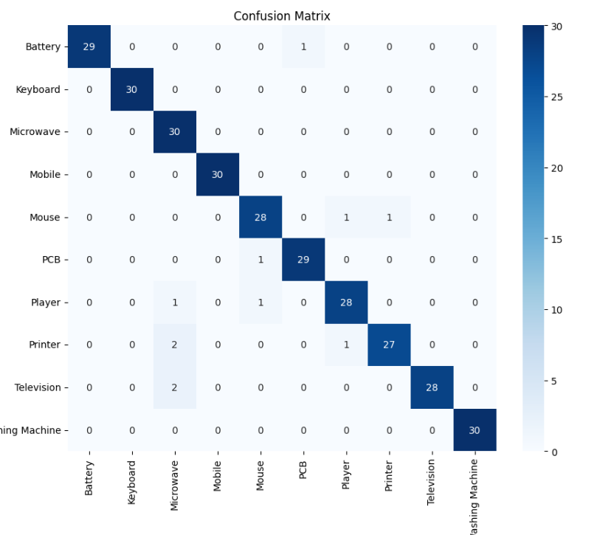
Screenshot of Output:

Slide 8
Conclusion:
Achieved high accuracy (96.33%) with half the parameters of the previous model.
MobileNetV3 reduced training time and improved performance.
Functional API enabled better architectural control.
AdamW + dropout improved generalization on unseen data.
Deployment-ready with lightweight structure and Gradio integration.
Better suited for limited hardware (like Colab or mobile devices).

